Slide 1
Transcriptomics data analysis using NetworkAnalyst
Metabolomics 2019
Guangyan Zhou (guangyan.zhou@mail.mcgill.ca)
June 23, 2019

Slide 2
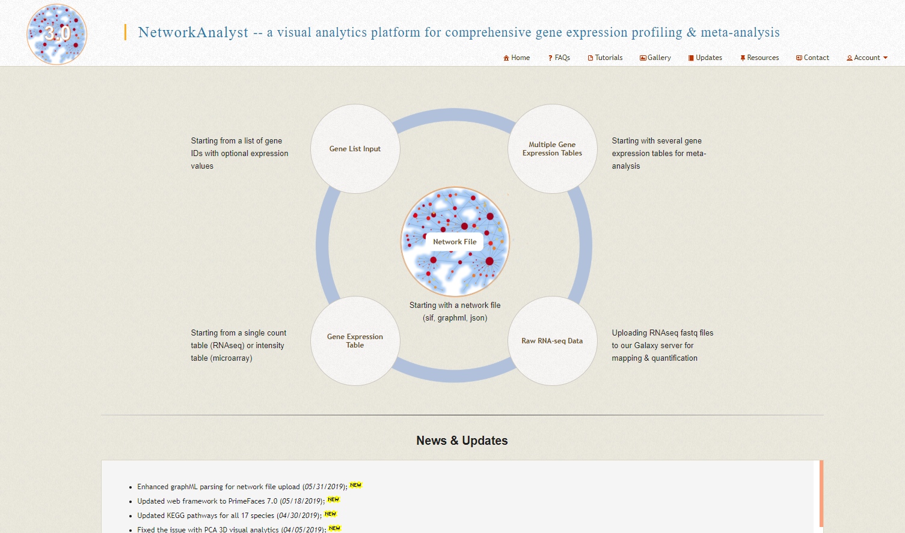
Objective
Use NetworkAnalyst to perform statistical and functional analysis on a study of breast cancer.
The results produced will be used as input for multi-omics integration within OmicsNet (https://www.omicsnet.ca/).

Slide 3
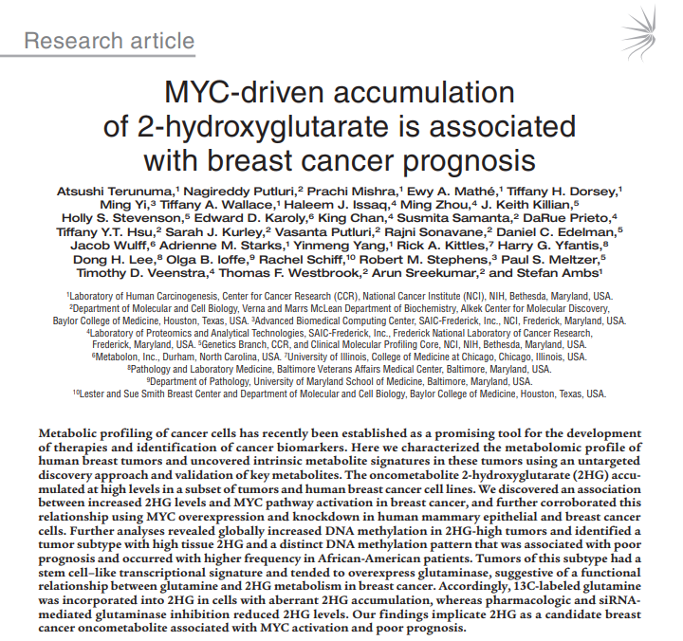
Data
67 human breast tumors and 65 tumor-adjacent noncancerous tissue samples from a study of the onset of breast cancer.
Untargeted metabolomics (Metabolon) of 352 known metabolites and microarrary analysis (Affymetrix Human Gene 1.0 ST Array) of tissue samples.
Download the “breast_cancer.zip” zipped folder from the tutorials page of OmicsNet.

Slide 4
Click here to start

Slide 5
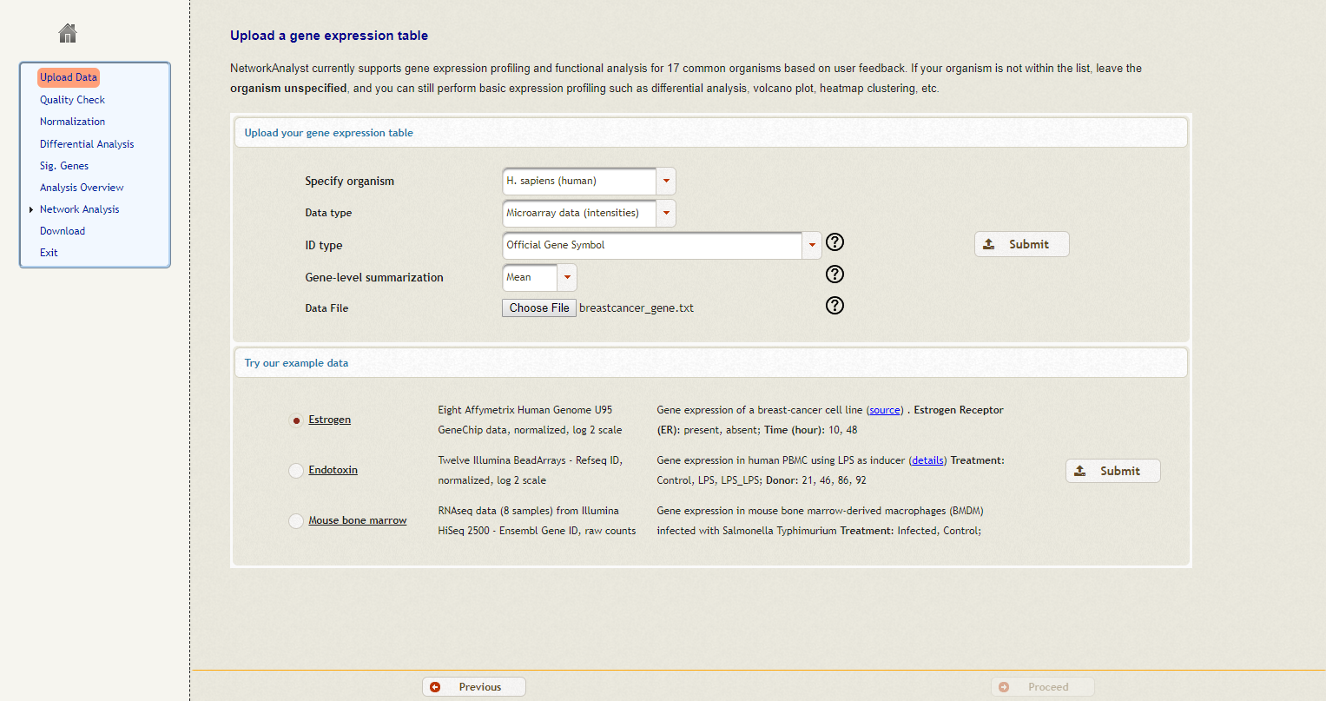
Set the organism to “Human”, Data type to “Microarray data”, ID type to “Official Gene Symbol”, select the “breastcancer_gene.txt” file and click “Submit”. Then Click “Proceed” to move forward.

Slide 6
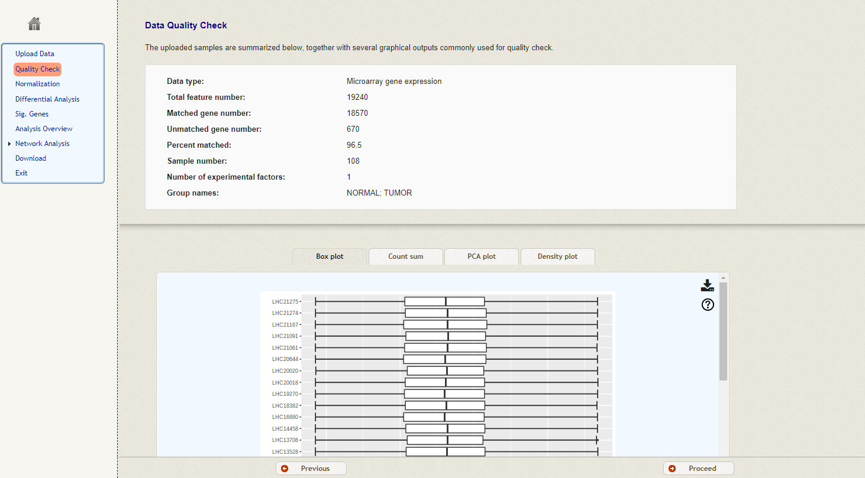
Click “Proceed“ to move forward

Slide 7
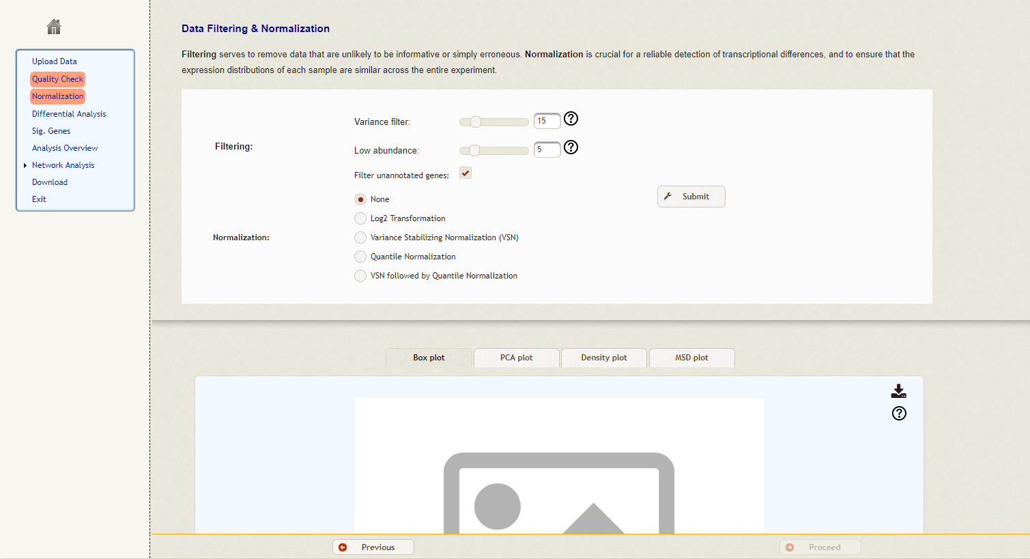
Keep the filtering set to default, normalization set to none (data is already normalized as per the QC graphics on the previous page) and click “Submit”. After click “Proceed” below.

Slide 8
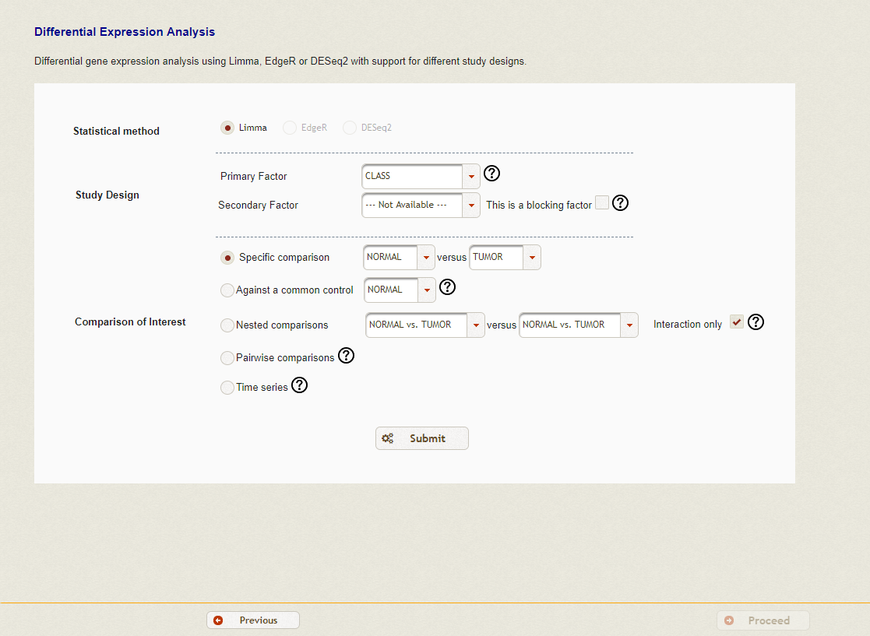
Perform differential expression analysis. Keep everything as default, click “Submit” and then “Proceed”.

Slide 9
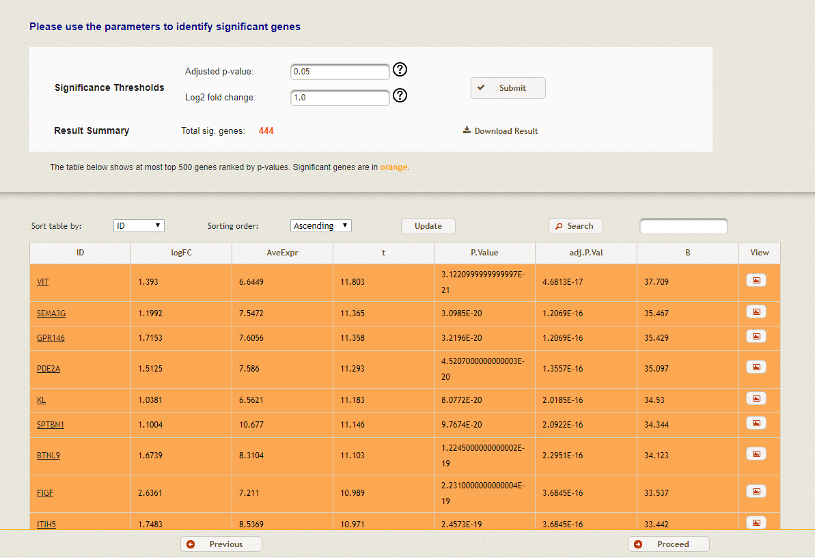
DE genes result and export
A total of 444 DE genes were identified. To explore the analysis results, click “Procced” to move forward.
Download table here

Slide 10
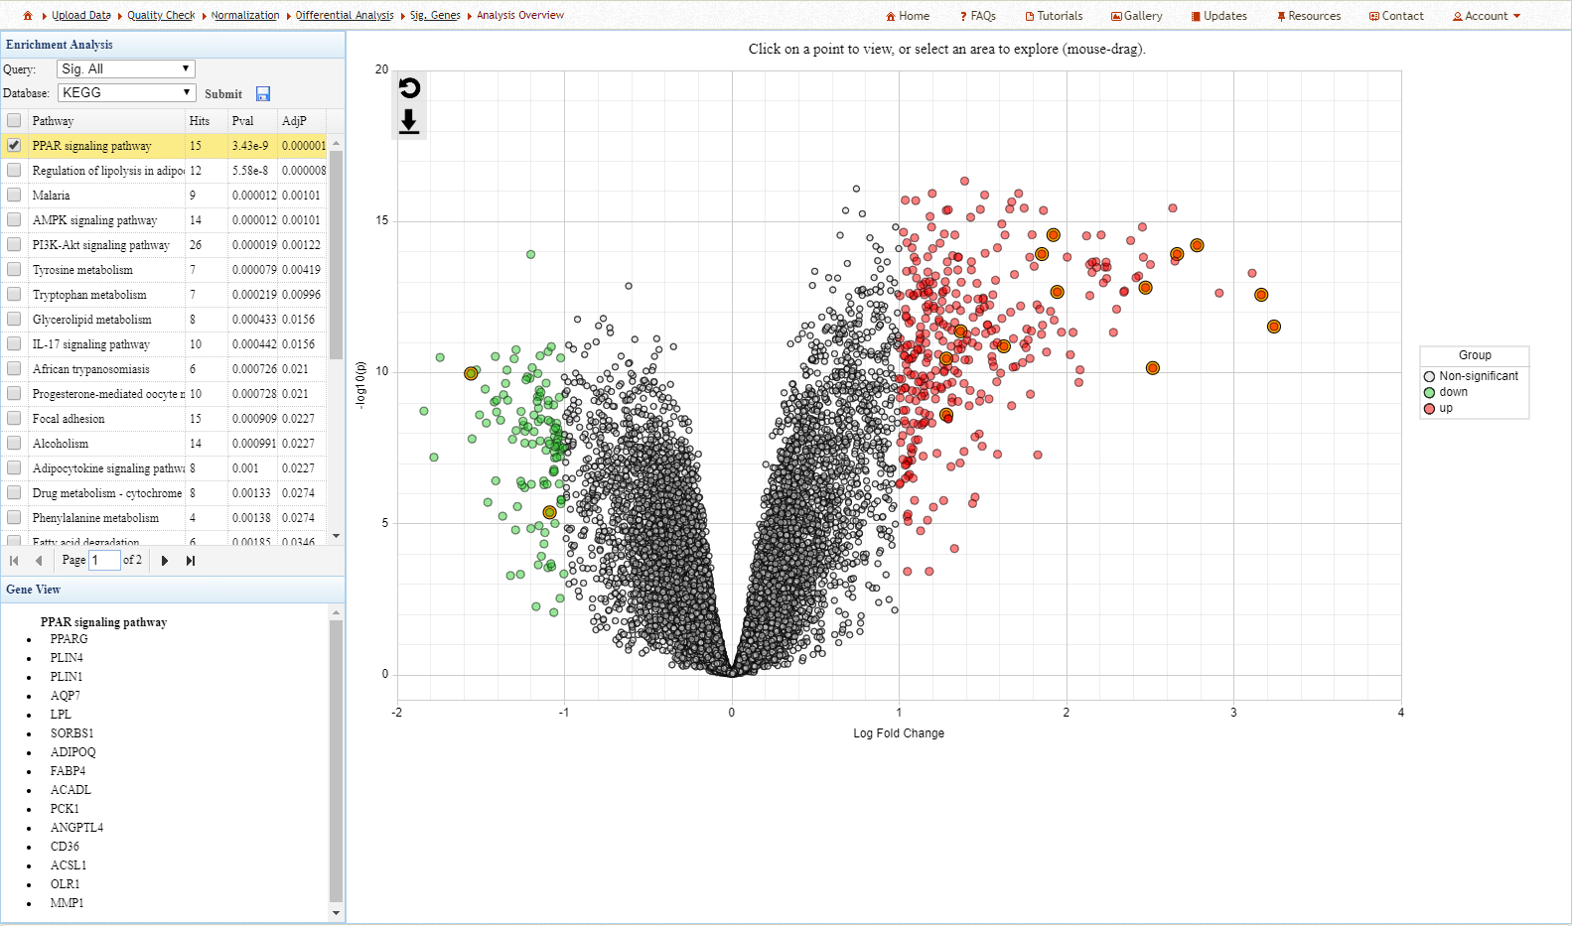
Interactive volcano plot
The left-panel contains the results of KEGG enrichment analysis on the DE genes. Click on any pathway to highlight matching genes.
Up-regulated genes are red and down-regulated genes are green. Hover over any gene to view its name, -log10 p-value and log2 fold-change.

Slide 11
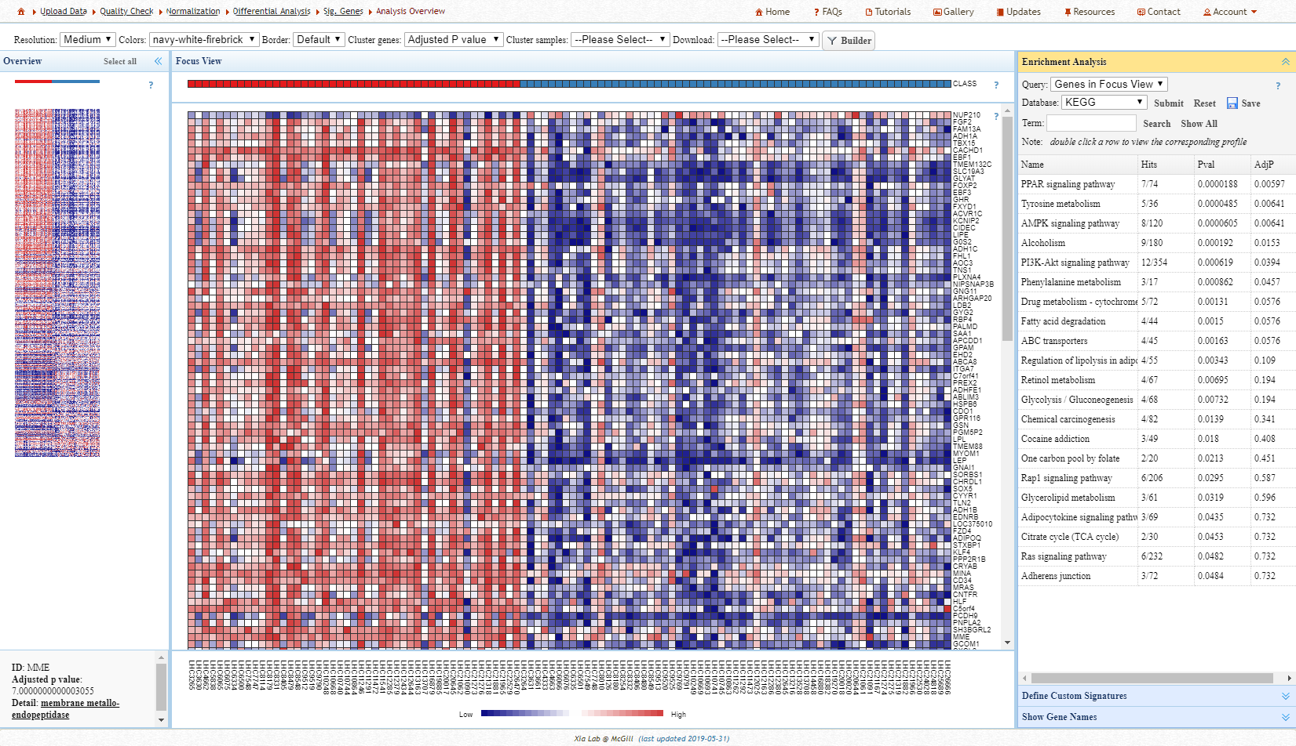
ORA Heatmap
The interactive heat map permits users to perform enrichment analysis and define gene signatures using groups of genes from the heatmap.
Click here to start

Slide 12
ORA Heatmap
Select a group of genes from the Overview by dragging with your mouse. The selected genes will appear in the Focus View.
Click here to start

Slide 13
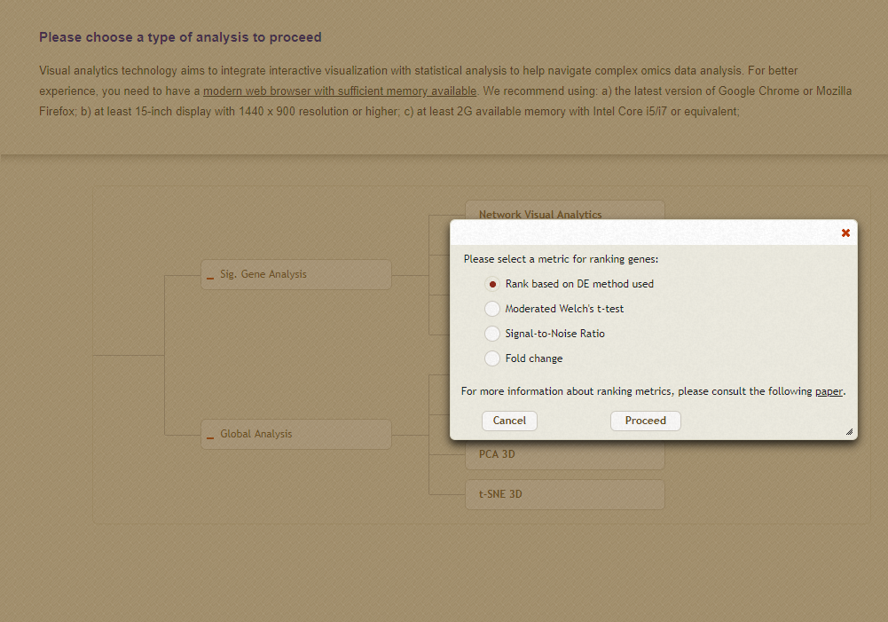
Gene set enrichment analysis (GSEA)
GSEA is a commonly used method to interpret gene expression data.
The method determines if the expression of an a priori set of genes (i.e. biological pathways) is correlated with phenotypic differences between groups.
Compared to previous methods, GSEA incorporates actual gene expression data and is more sensitive to differences.
Select the “GSEA Heatmap Clustering”. Explore the results using different ranking methods.

Slide 14
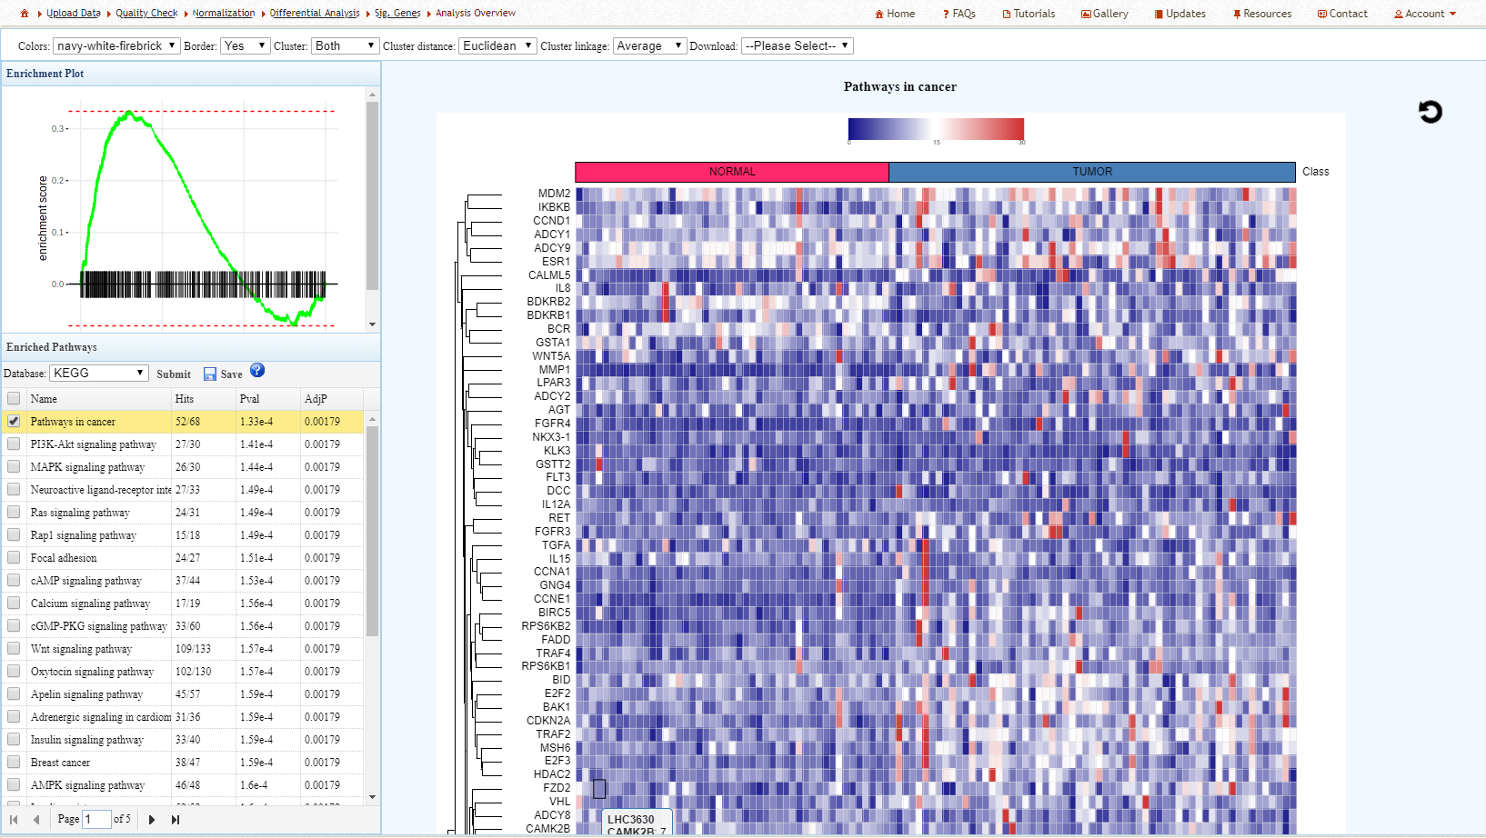
GSEA heatmap
GSEA results. Select a pathway to view the corresponding Enrichment plot and heatmap. Pathways in cancer is one of the top most enriched sets.

Slide 15
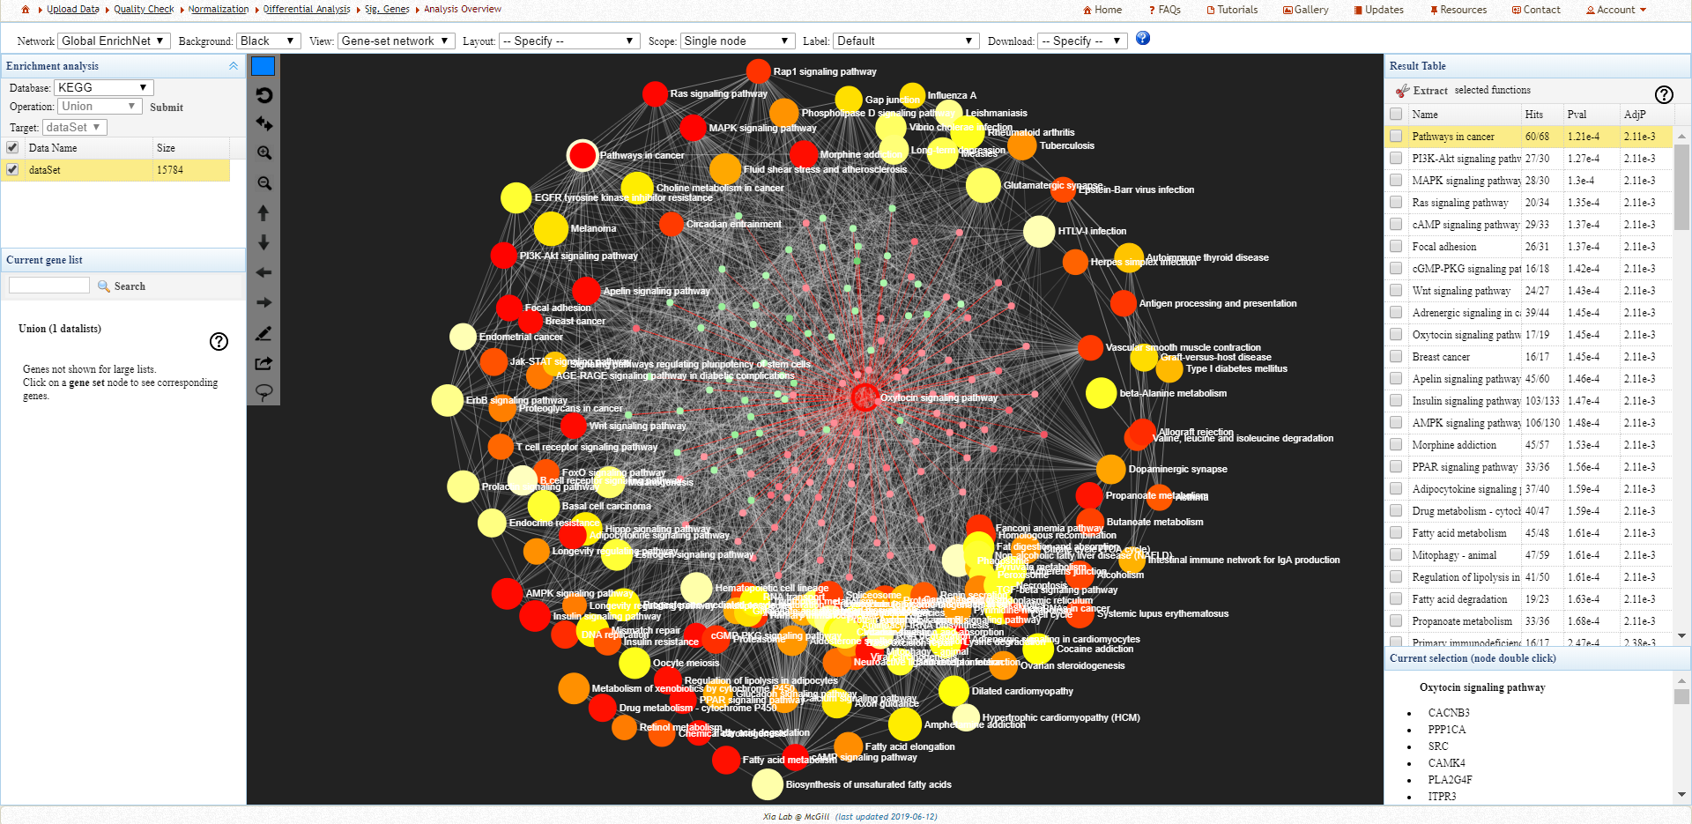
GSEA Enrichment network
Network visualization facilitates the interpretation of GSEA results. Each node represents a significantly enriched gene set from GSEA. Gene sets are connected based on their similarity.
Double clicking a node will show genes involved in the particular pathway colored by their expression value

Slide 16
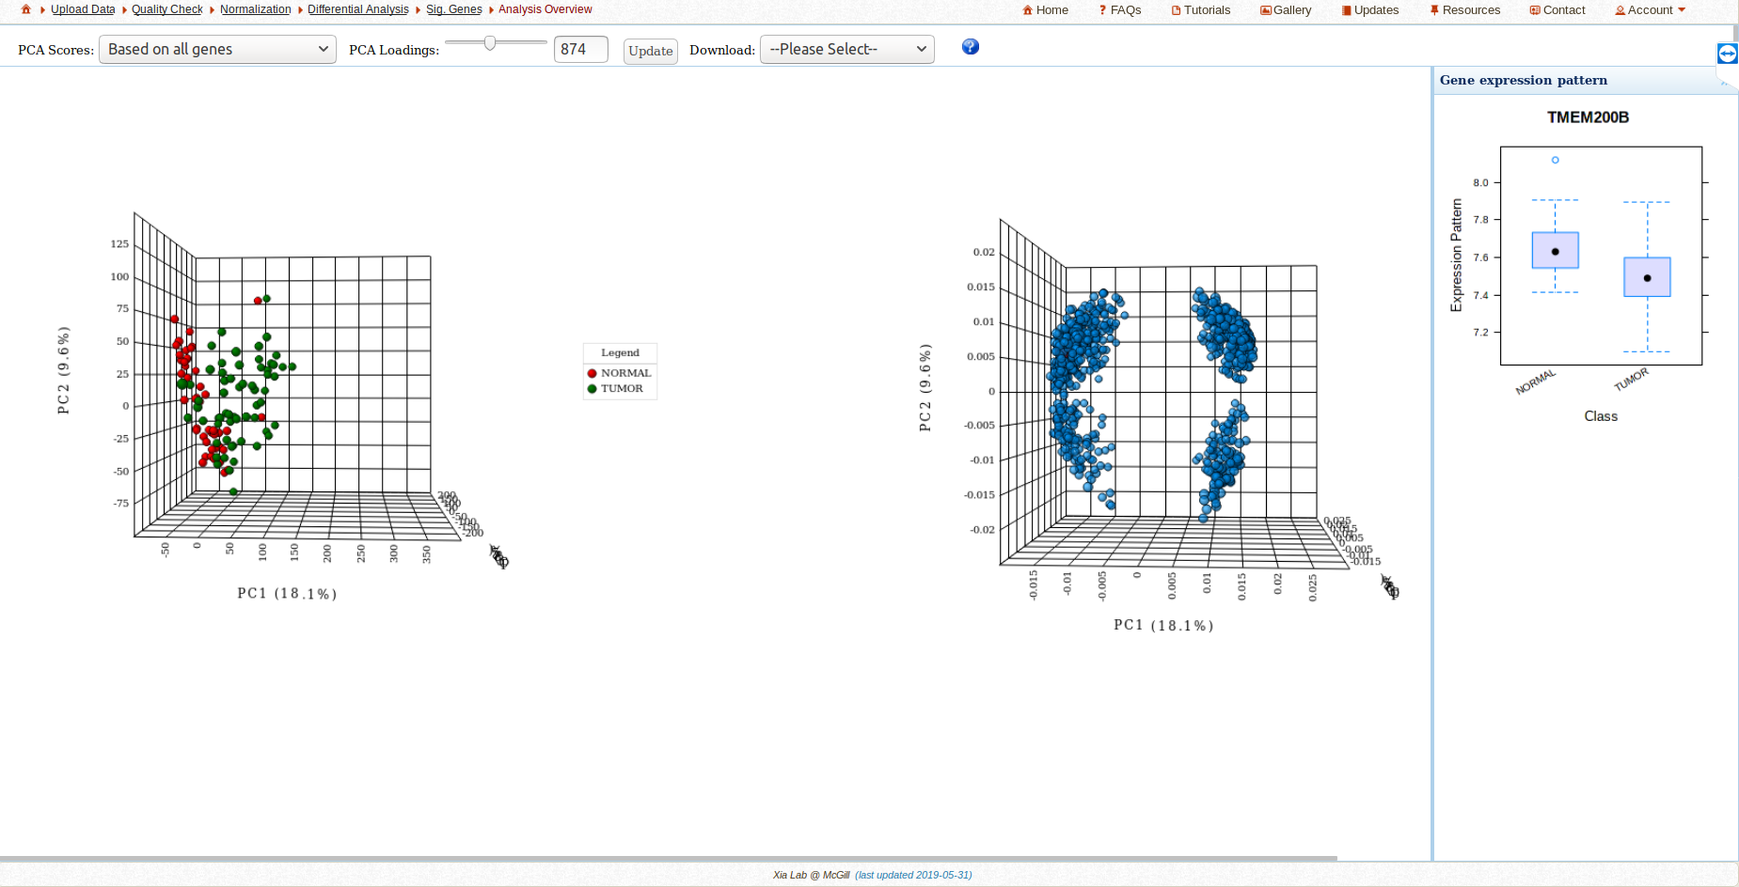
Synchronized PCA/Loading plots

Slide 17
Further exploration
Refer to the FAQs, Tutorials, and Resources page of NetworkAnalyst for more information.
For a detailed step-by-step tutorial, read the “NetworkAnalyst for Statistical, Visual and Network-based Approaches for Meta-analysis of Expression Data” Nature Protocol.

Slide 18
References
Zhou G, Soufan O, Ewald J, Hancock RE, Basu N, Xia J. NetworkAnalyst 3.0: a visual analytics platform for comprehensive gene expression profiling and meta-analysis. Nucleic acids research. 2019 Apr 1.
Terunuma A, Putluri N, Mishra P, Mathé EA, Dorsey TH, Yi M, Wallace TA, Issaq HJ, Zhou M, Killian JK, Stevenson HS. MYC-driven accumulation of 2-hydroxyglutarate is associated with breast cancer prognosis. The Journal of clinical investigation. 2014 Jan 2;124(1):398-412.
Subramanian A, Tamayo P, Mootha VK, Mukherjee S, Ebert BL, Gillette MA, Paulovich A, Pomeroy SL, Golub TR, Lander ES, Mesirov JP. Gene set enrichment analysis: a knowledge-based approach for interpreting genome-wide expression profiles. Proceedings of the National Academy of Sciences. 2005 Oct 25;102(43):15545-50.

